Slide 1
INFOSYS SPRINGBOARD
INTERNSHIP
Project Title
ANOMALY DETECTION
Problem Statement | Dataset Overview | EDA | Pre-Processing | Modelling & Results – K-means & DBSCAN | ML-algorithms | Autoencoders | Conclusion | Q&A
TUSHAR MADHUKAR BHAGAT

Slide 2


In this project, we delve deep into the thriving sector of Security by analyzing a Anomaly detection on Healthcare Dataset from a USA-based Health Service Providers, available at the kaggle. This dataset documents all transactions between patients and service providers. Our primary objective is to amplify the efficiency of Healthcare System and avoid fraudulent transactions in Healthcare system. We aim to transform the data into a -centric dataset that will facilitate the Base for Anomaly Detection system of patient providing better service , ultimately enhancing security ,efficiency and patient service.
Problem Statement :

Slide 3
Dataset Overview:
Column Name | Null values | Data Type
National Identity Provider | 0 | Int
Last Name/Organisation Name of the Provider | 0 | Object
First Name of the Provider | 4255 | Object
Middle initial of the Provider | 29331 | Object
Credentials of the Provider | 7209 | Object
Gender of the Provider | 4254 | Object
Entity type of the provider | 0 | Object
Street address 1 of the provider | 0 | Object
Street address 2 of the provider | 59363 | Object
City of the Provider | 0 | float
Zip code of the Provider | 0 | Object
State code of the Provider | 0 | Object
Country code of the Provider | 0 | Object
Provider Type | 0 | Object
Medicare Participation Indicator | 0 | Object
Total rows : 100000
Total columns : 26

Slide 4
Dataset Overview:
Column Name | Null values | Data Type
Place of Service | 0 | Object
HCPCS Code | 0 | Object
HCPCS Description | 0 | Object
HCPCS Drug indicator | 0 | Object
Number of Services | 0 | Object
Number of Medicare Beneficiaries | 0 | Object
Number of Distinct Medicare Beneficiary /per day Services | 0 | Object
Average Medicare allowed amount | 0 | Object
Average Submitted charge amount | 0 | Object
Average Medicare Payment amount | 0 | float
Average Medicare Stadardized amount | 0 | Object
Total rows : 100000
Total columns : 26
Object : 24
Float : 1
Int : 1

Slide 5
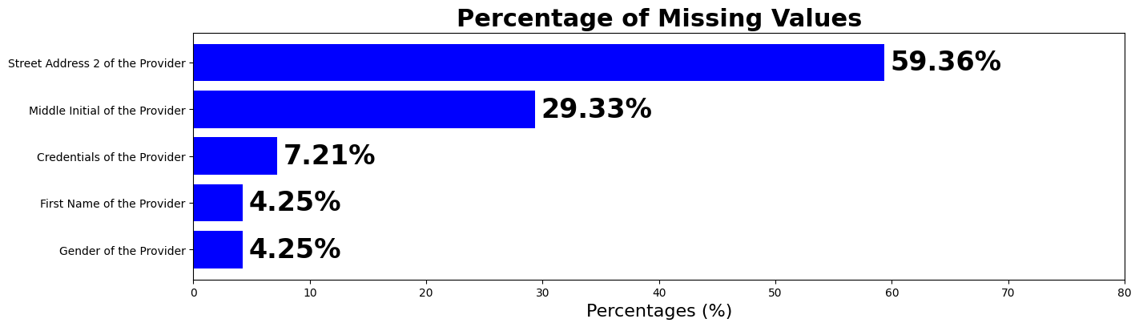
EDA
The above barplot shows the Initial Missing values in the Dataset in the percentage:
Where
Street Address 2 of the Provider has highest 59.36% Missing values
Middle Initial of the Provider has 29.33% Missing values
Credentials of the Provider 7.21% Missing values
First Name of the Provider 4.25% Missing values
Gender of the Provider 4.25% Missing values

Slide 6
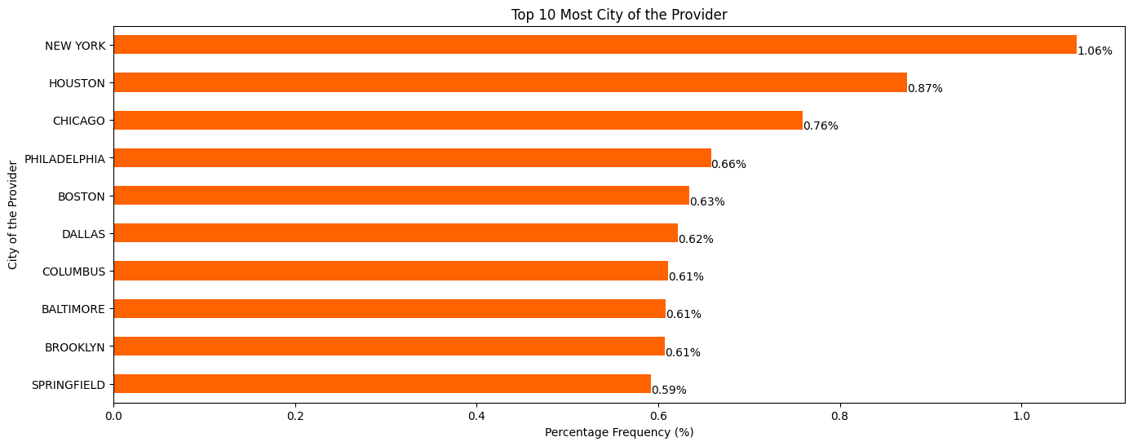
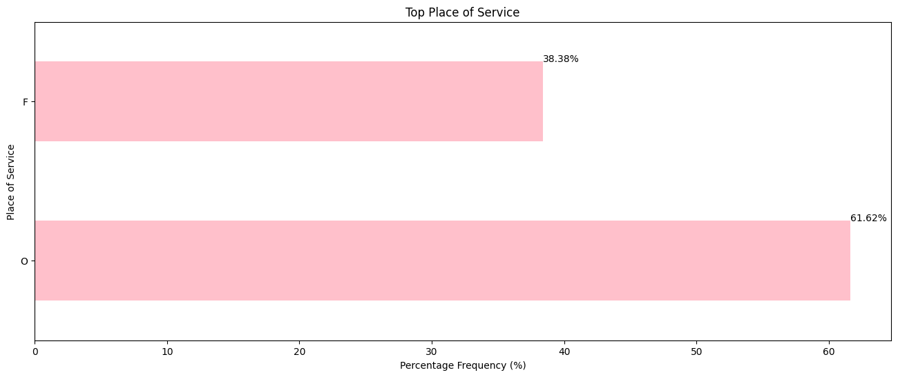
EDA
The above barplot shows the Top 10 city in the Dataset
in the percentage:
Where
New York city has highest 1.06% occurrence in data
Houston city has 0.87% occurrence in data
Followed by Chicago, Philadelphia, Boston, Dallas
And other
The barplot shows the Contribution of Places in the Dataset
in the percentage:
Where
Facility has contributed 38.38%
Non Facility has contributed 61.62%

Slide 7
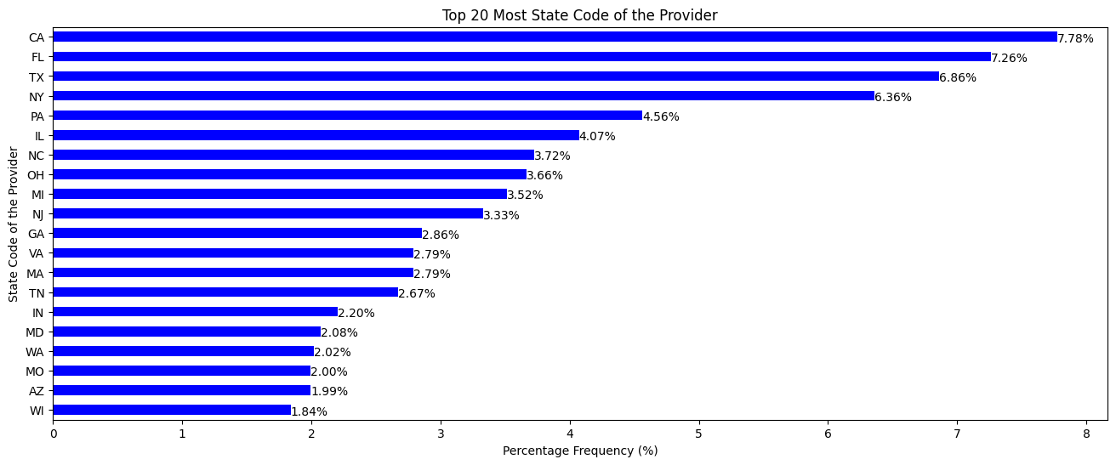
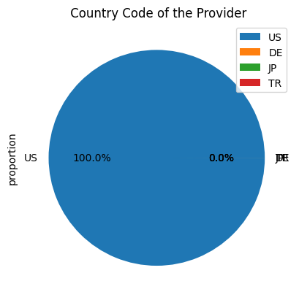
EDA
The above barplot shows the Top 20 States in the Dataset
in the percentage:
Where
California State has highest 7.78% occurrence in
data
Florida state has 7.26% occurrence in data
Followed byTexas, New York
And others
The pie chart shows the Countries in the Dataset
in the percentage:
Where
US has contributed majority all 100.00%
Other has contributed 0.0%

Slide 8
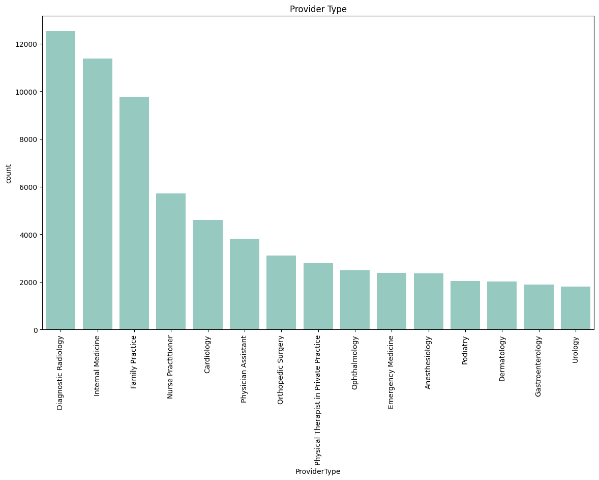
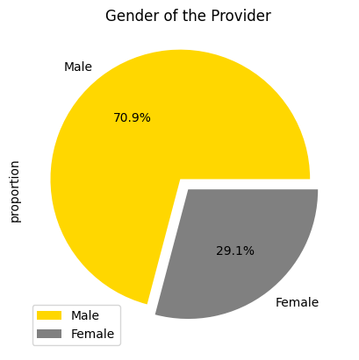
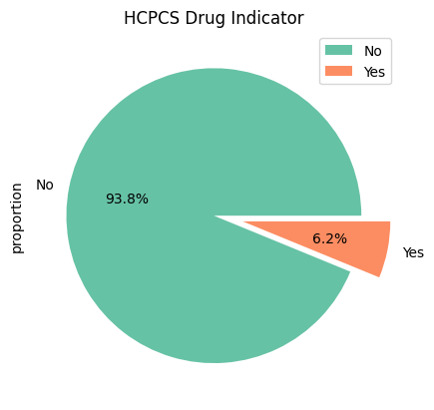
EDA
The above barplot shows the Top Provider types
in the Dataset in the percentage:
Where
Diagonostic Radiology has highest 13000 entries in
data
Internal medicine has 11000 entries in data
Followed by Family Pratice, Nurse Practitioner
And others
The pie charts shows the Distribution of Gender
And HCPCS drug indicator in the Dataset
in the percentage:
Where
Male gender is dominate with 70.9% entries
HCPCS drug indicator marked as No has 93.8%
entries

Slide 9
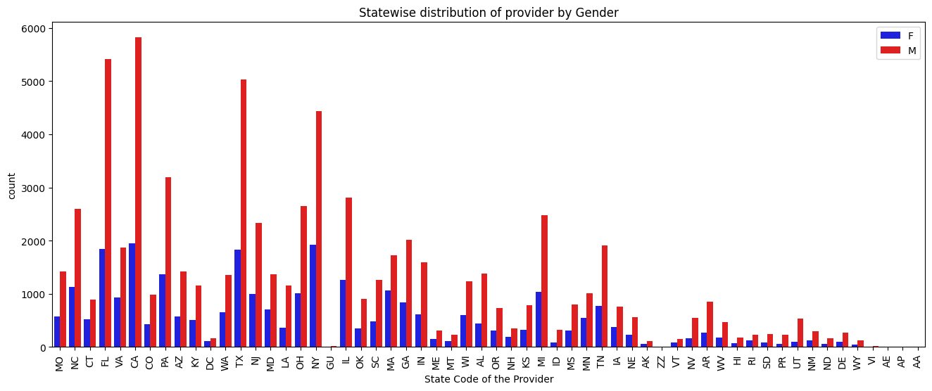
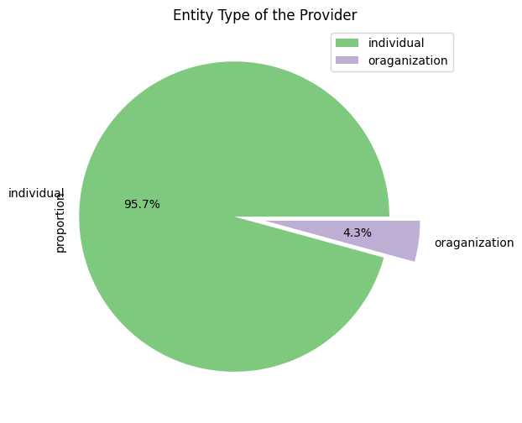
EDA
The above barplot shows the Staewise distribution of gender
in the Dataset :
Where
Florida and California has highest male entries above
5000 in data
The pie chart shows the Distribution of Entity Type of the Provider in the Dataset in the percentage:
Where
Individual entity is dominate with 95.7% entries
Organization has only 4.3% entries

Slide 10
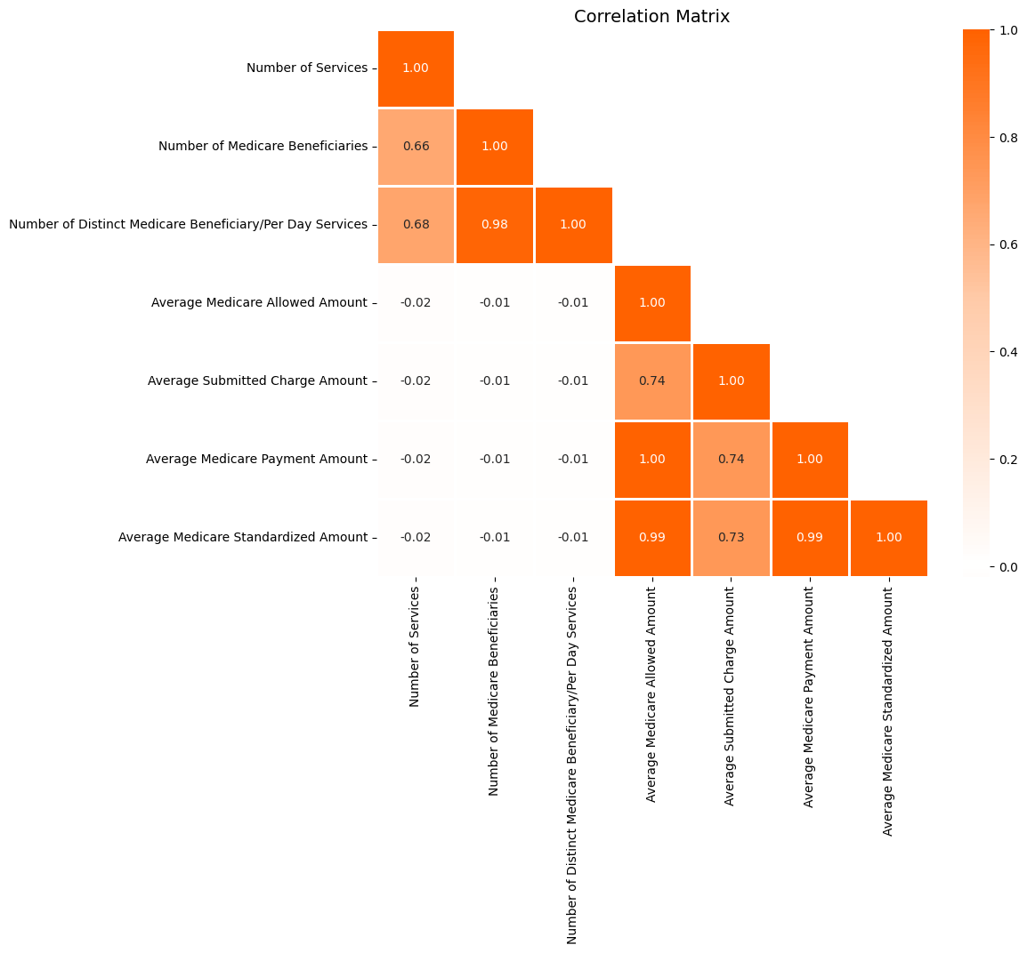
EDA
The Correlation Matrix shows the Association/Co-relation between Numerical columns in the Dataset :
Where
Average Medicare standardized amount and Average Medicare Payment amount is highly correlated 0.99
There are some columns which shows high correlation which are present in upper left and lower right of matrix

Slide 11
Pre-Processing & Feature Engineering
Handling Missing Values
Merged all the names columns into one column to avoid missing values same strategy used for the Address column to overcome from missing values
Replaced categorical values with mode
Feature Engineering
Generated new feature called “Diff submitted allowed” which shows the difference between Average Submitted Charge Amount and Average Medicare Allowed Amount
Feature Encoding
Categorical colums with two unique values encoded with Binary encoding
Categorical columns with high cardinal values are encoded with Frequency encoding.

Slide 12
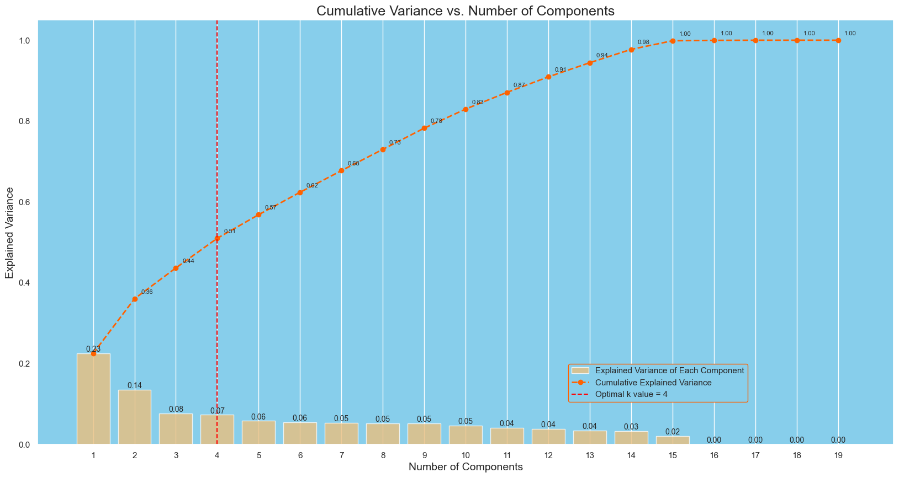
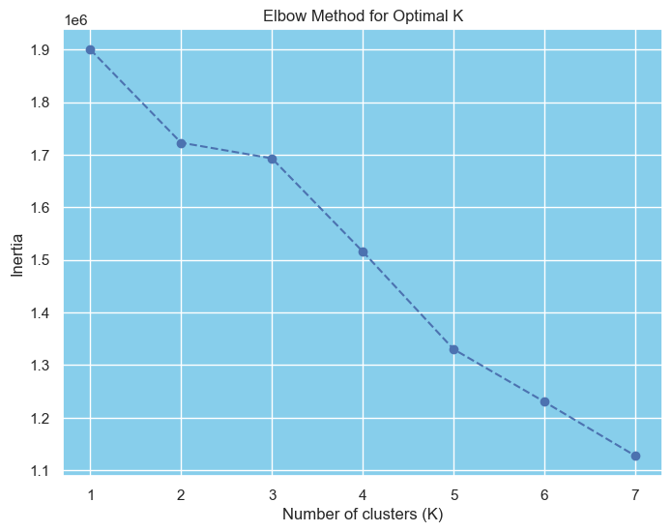
Modeling & Results
K-Means Clustering
The graph shows the optimum no cluster to choose for K-means Clustering and Optimum no of components for PCA :
Where
Above graph shows the no of components for Dimensionality reduction PCA where each component is shown with cumulative variance captured by them
The elbow point graph on left side represent the optimum no of cluster for the k-means clustering which 2 no of optimum clusters.

Slide 13
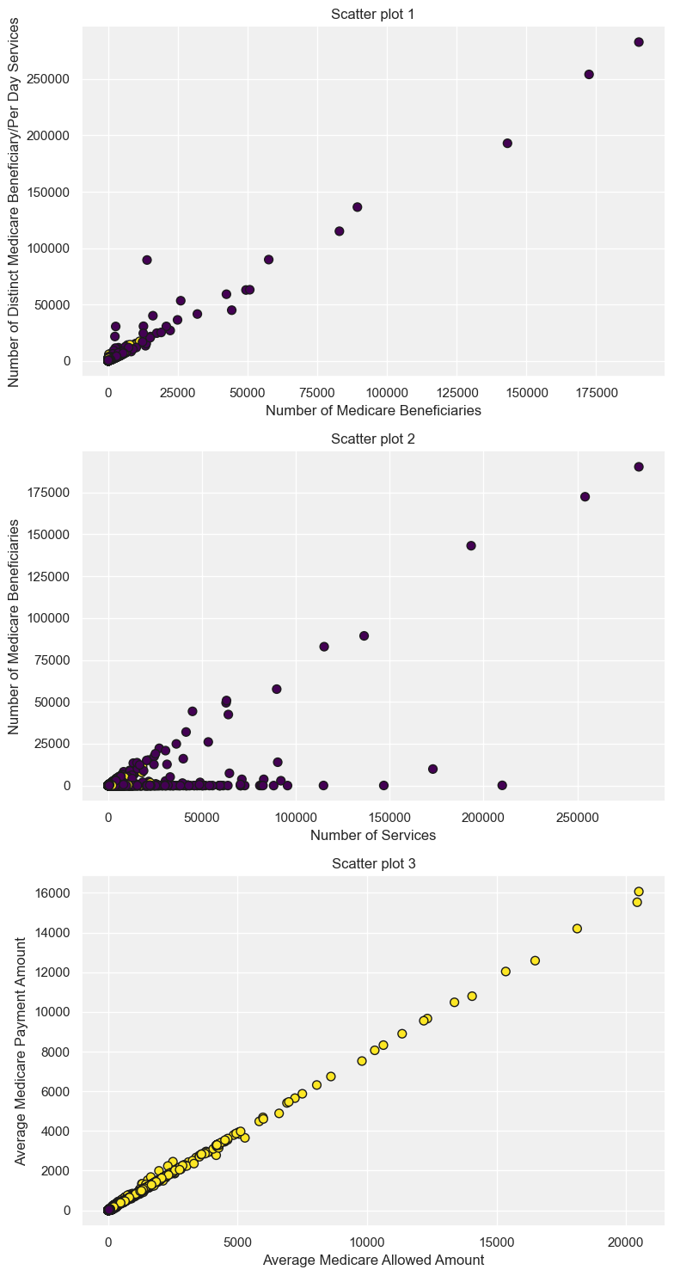
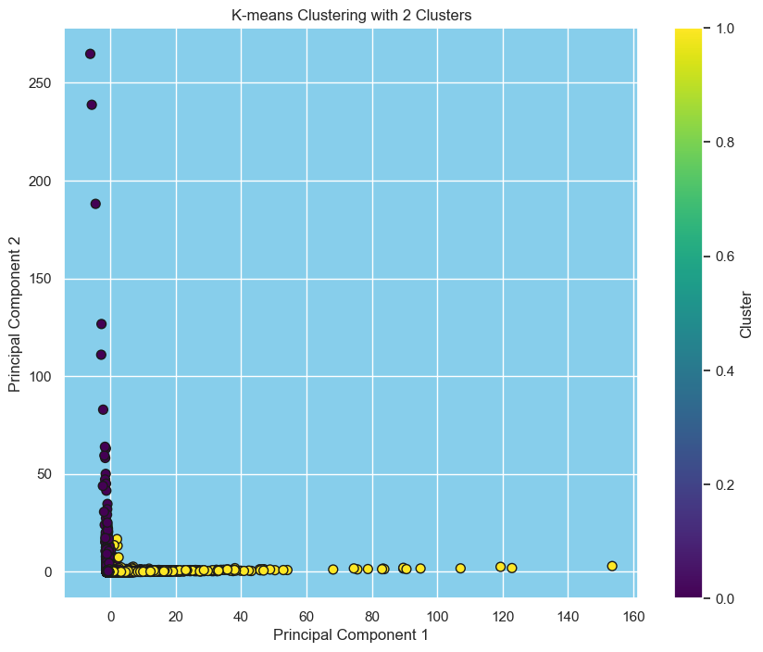
Modeling & Results
K-Means Clustering
The Scatter Plots shows the Distributions of cluster for K-means :
Where
Above plot shows the PCA components where clusters are plotted for k-means
The subplots on the right side shows the distribution of the clusters against Numerical columns
We can see that k-means clustering is able to distinctly classify clusters

Slide 14
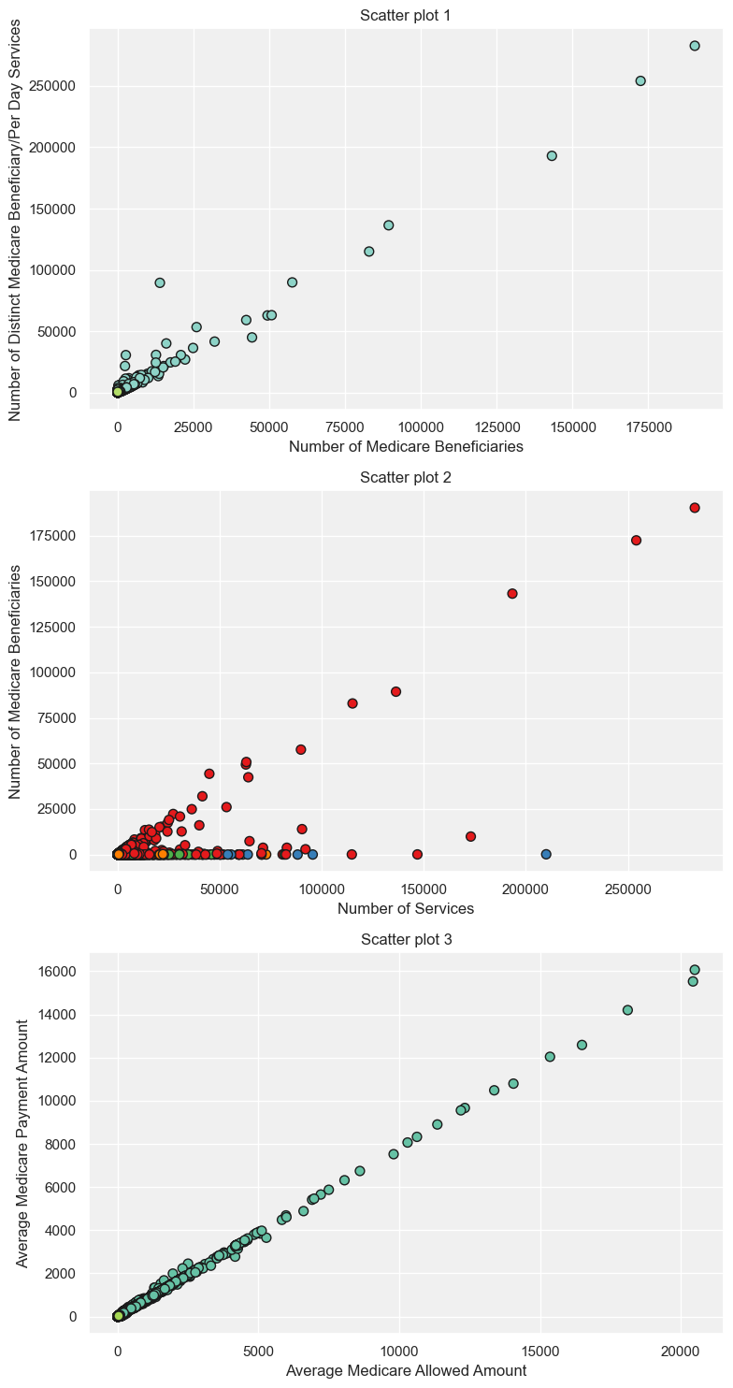
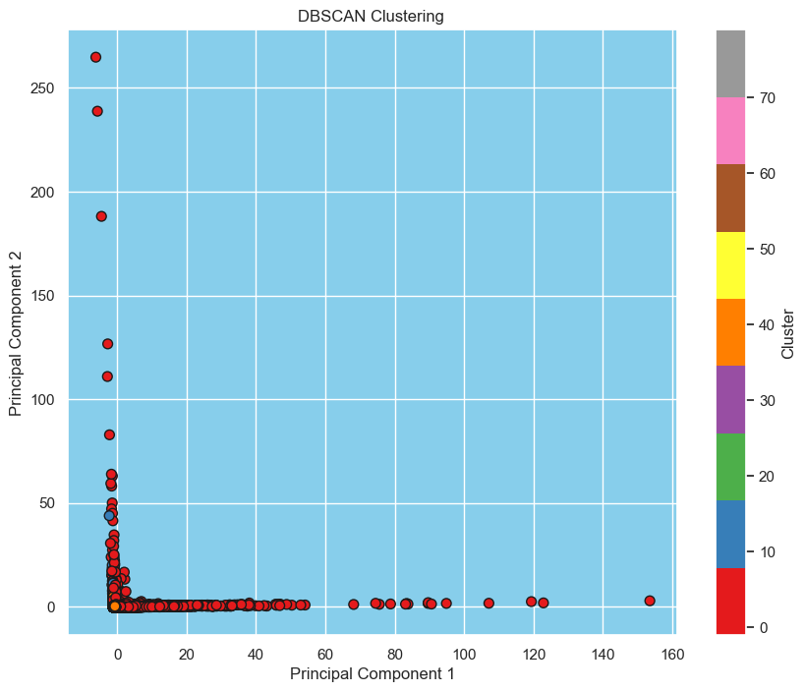
Modeling & Results
DBSCAN Clustering
The Scatter Plots shows the Distributions of cluster for DBSCAN:
Where
Above plot shows the PCA components where clusters are plotted for DBSCAN
The subplots on the right side shows the distribution of the clusters against Numerical columns for DBCAN algorithm
We can see that DBSCAN clustering is able to classify clusters and map different
clusters.

Slide 15
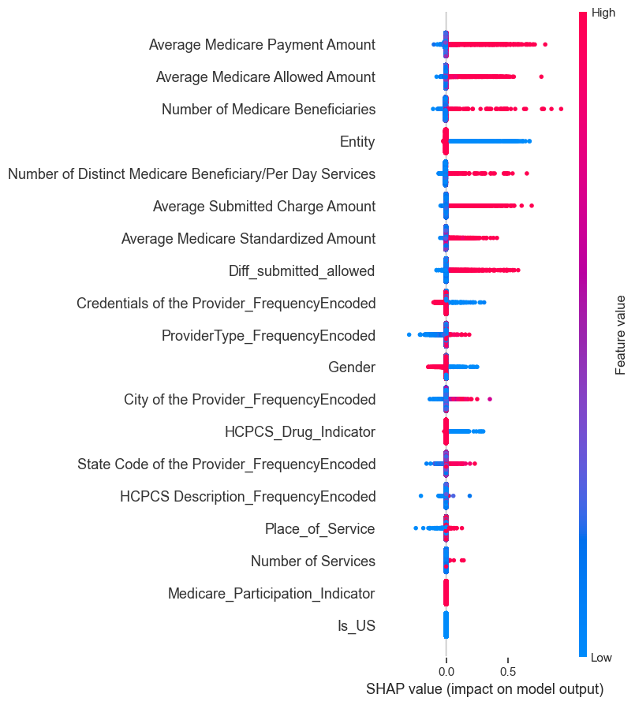
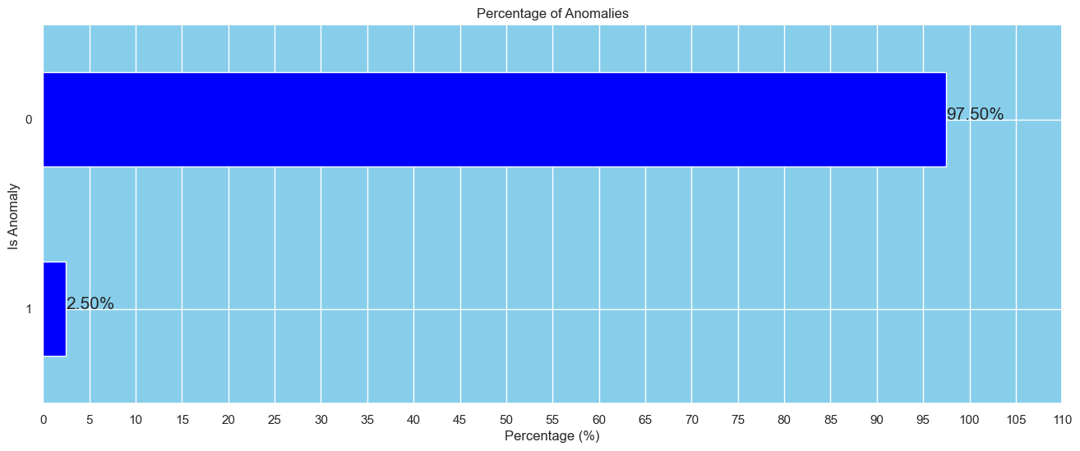
ML- Algorithms
Isolation Forest
The SHAP Analysis of Isolation forest shows the impact of columns on result/Prediction:
Where
Above plot shows that Average medicare payment amount & average medicare allowed amount has high positive impact on the model
The numerical columns has significantly contributed in decision making while only categorical value which is city has contributed to some extent.
The barplot below shows the anomaly detected by the isolation forest which is 2.50% i.e.2500.
Contamination Parameter : 0.025

Slide 16
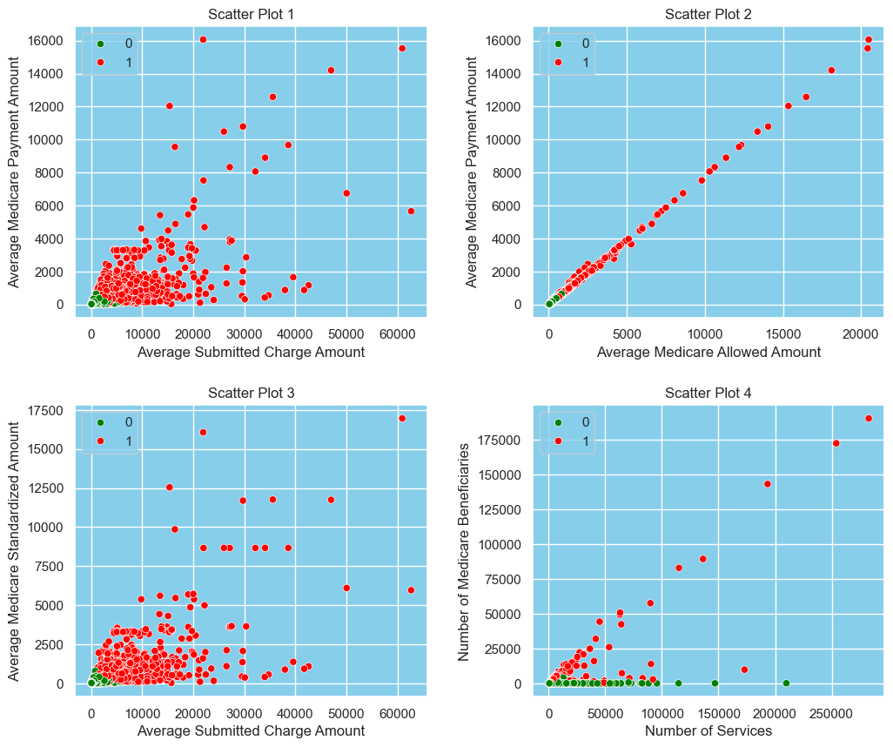
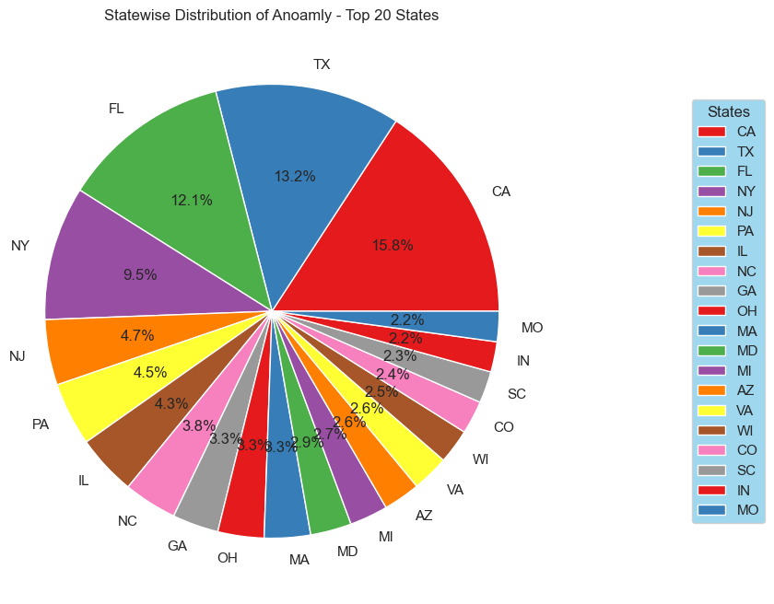
ML- Algorithms
Isolation Forest
The Scatter-plots on left shows Distribution of Anomalies by applying Isolation Forest:
Where
Red dots shows anomaly and Green dot Normal datapoints.
We can see that Isolation Forest is able to distinguishes between normal and anomalies.
The Pie- chart below shows the Top 20 states with highest anomalies :
Where
California has highest no of anomalies around 15.80% in total. Follwed by Texas with 13.20% and Florida 12.10%

Slide 17
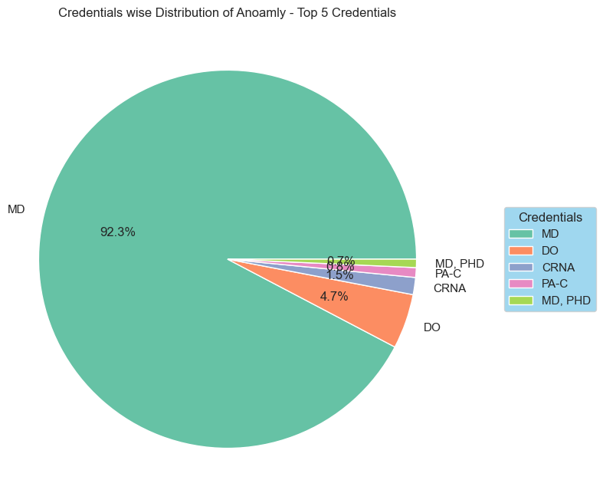
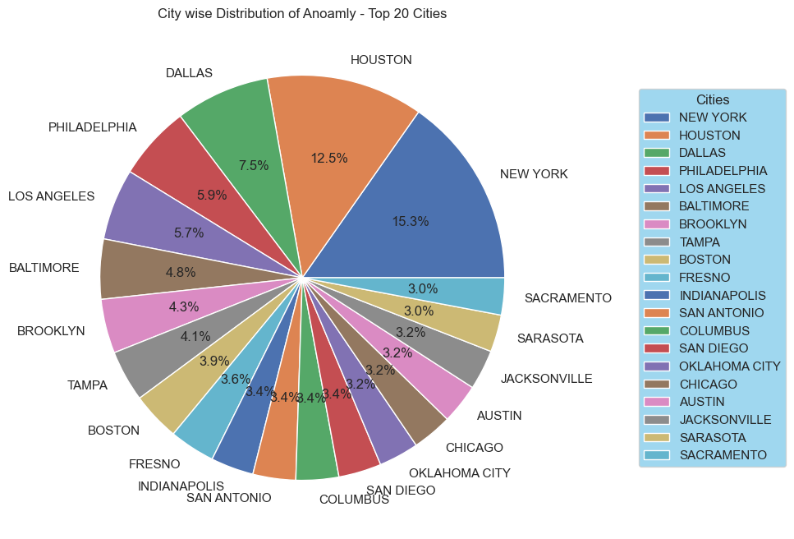
ML- Algorithms
Isolation Forest
The Pie chart on left shows Distribution of Anomalies in Top 20 Cities:
Where
New York city has highest no of anomalies around 15.30% in total.
Followed by the Houston city 12.50% anomaly and Dallas with around 7.50% anomaly.
The Pie- chart on right shows the Top 20 Credentials with highest anomalies :
Where
MD credentials has the highest no of anomalies around 92.30% anomalies.
DO credential has comparatively small no of anomalies in 4.70%

Slide 18
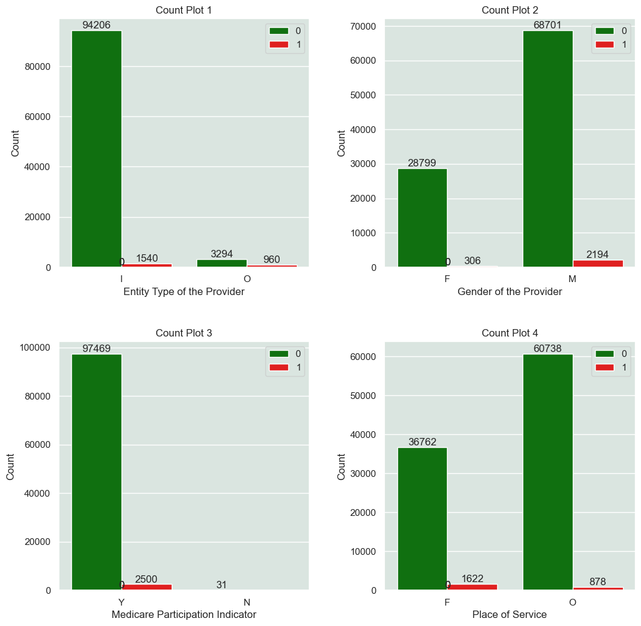
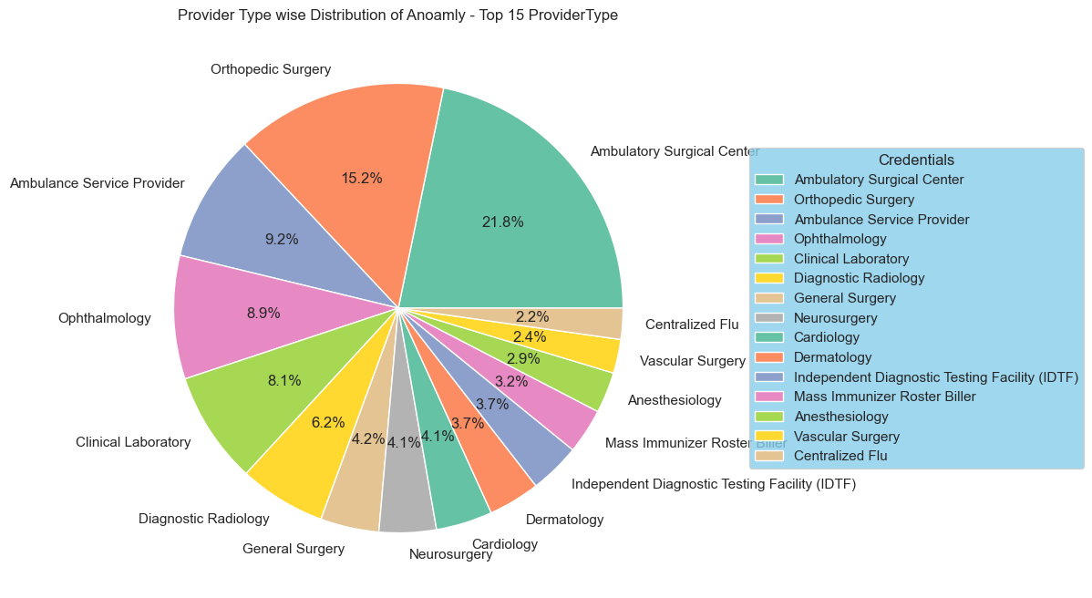
ML- Algorithms
Isolation Forest
Gender | Entity | Place | Medicare Participation indicator
Male-2197 | Individual-1540 | Facility-1622 | Yes-2500
Female-306 | Organization-960 | Non-Facility -878 | No-0
The pie chart below shows the distribution of Anomalies in Top 15 Provider Type:
Where
Ambulatory Surgical Center has the highest no of anomalies 21.8%
Followed by Orthopedic Surgery which has 15.2% , Ambulance Service Provider has 9.2% anomalies

Slide 19
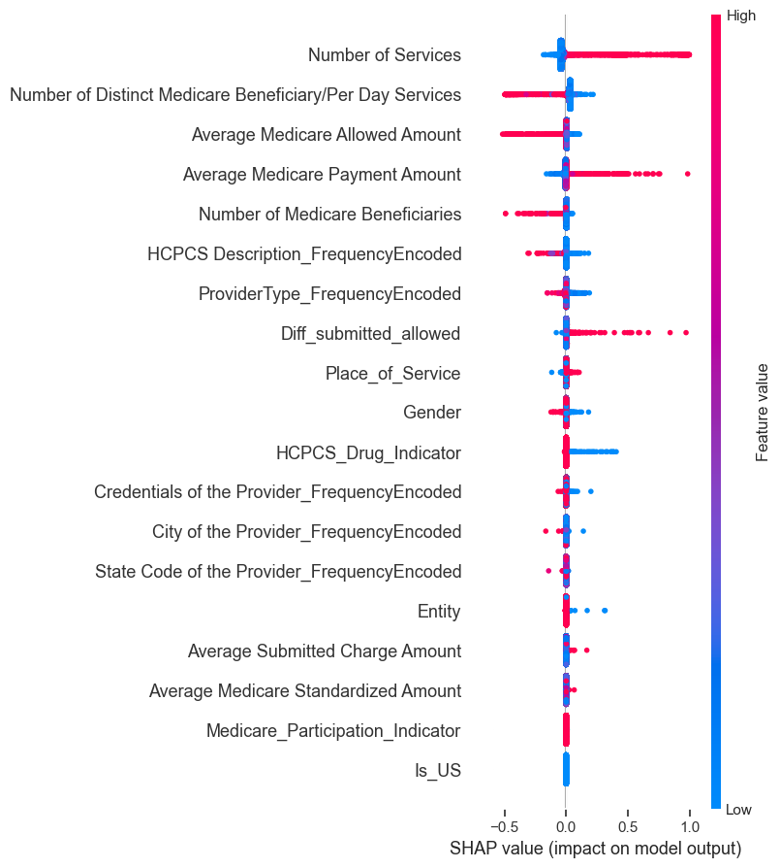
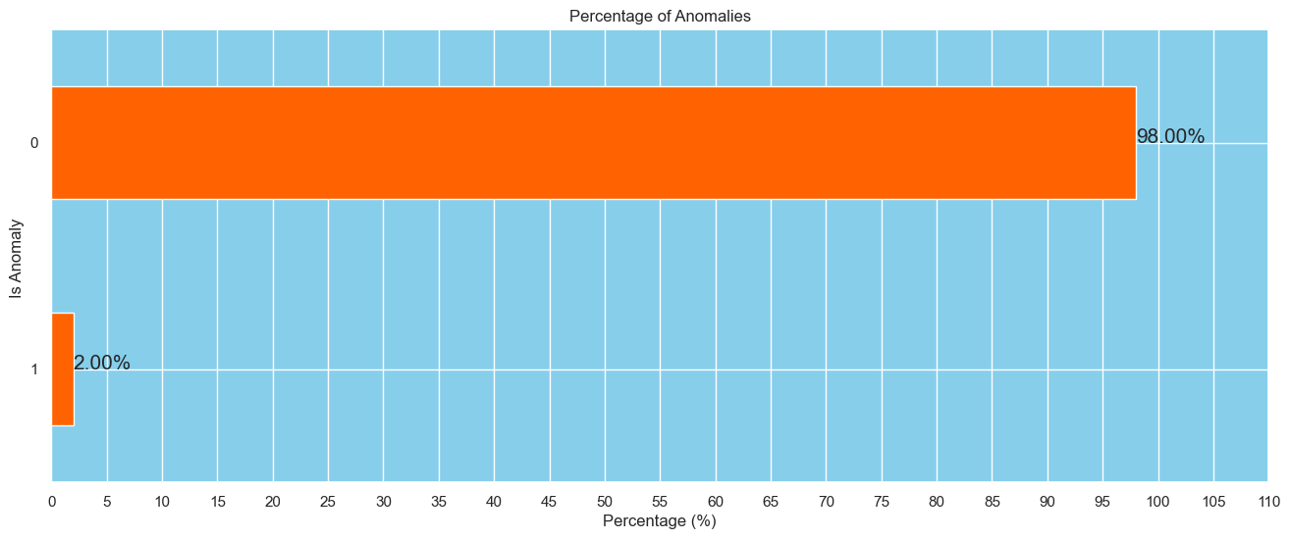
ML- Algorithms
Elliptic Envelope
The SHAP Analysis of Elliptic Envelope the impact of columns on result/Prediction:
Where
Above plot shows that Average medicare payment amount & average medicare payment amount has high positive impact on the model where as Average medicare allowed amount has negatively effected model output
The numerical columns has significantly contributed in decision making while only categorical value which is city has contributed to some extent.
The barplot below shows the anomaly detected by the Elliptic Envelope is 2.00% i.e.2000.
Contamination Parameter: 0.02

Slide 20
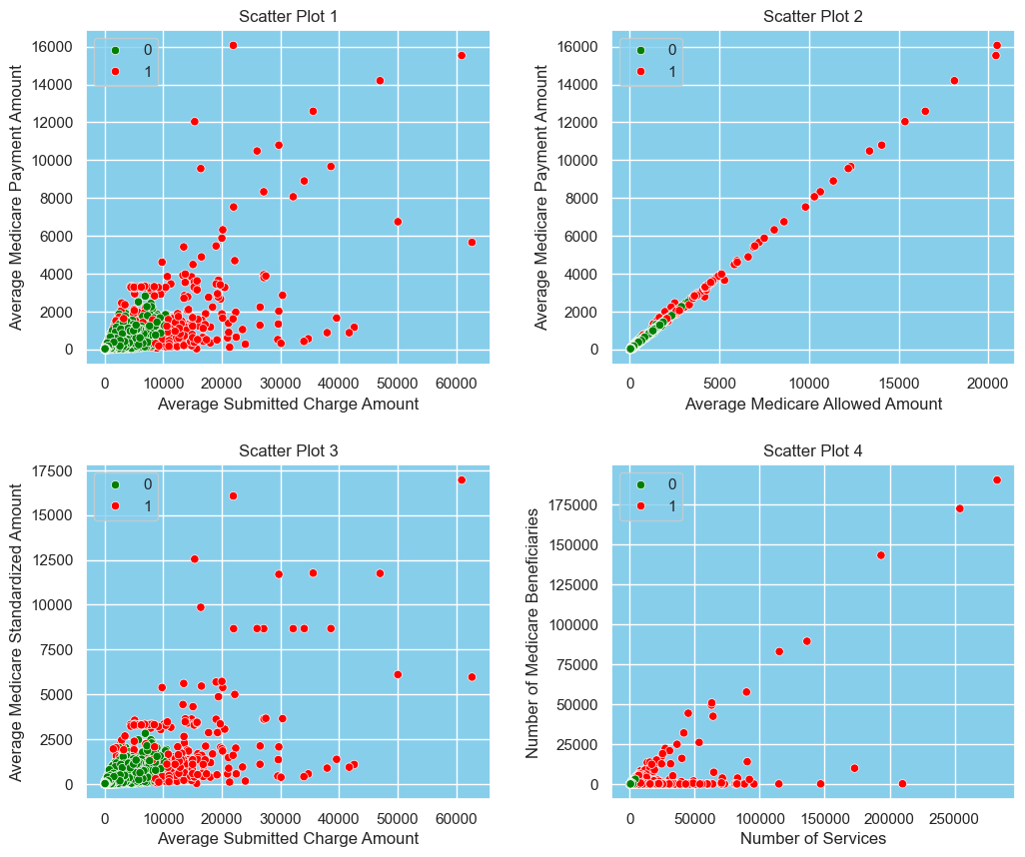
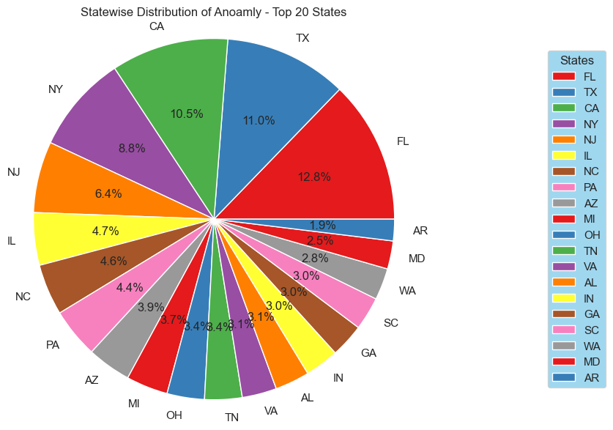
ML- Algorithms
Elliptic Envelope
The Scatter-plots on left shows Distribution of Anomalies by applying Elliptic Envelope:
Where
Red dots shows anomaly and Green dot Normal datapoints.
We can see that Elliptic Envelope is able to distinguishes between normal and anomalies.
The Pie- chart below shows the Top 20 states with highest anomalies :
Where
Florida state has highest no of anomalies around 12.08% in total. Follwed by Texas with 11.0% and California 10.5%

Slide 21
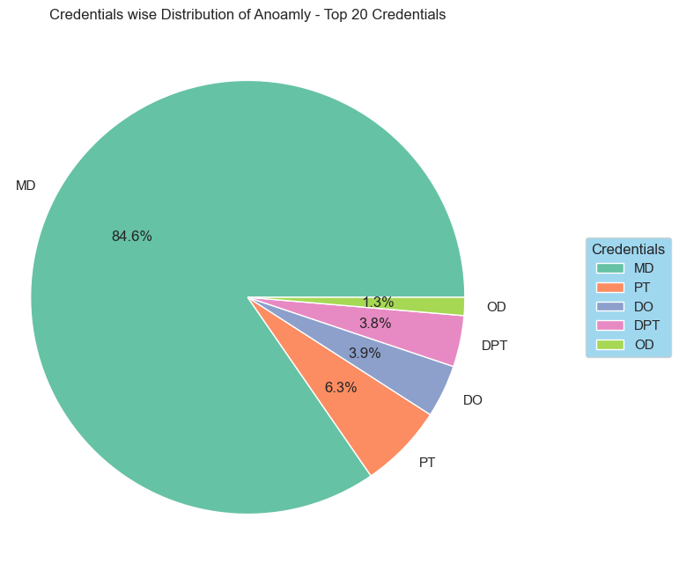
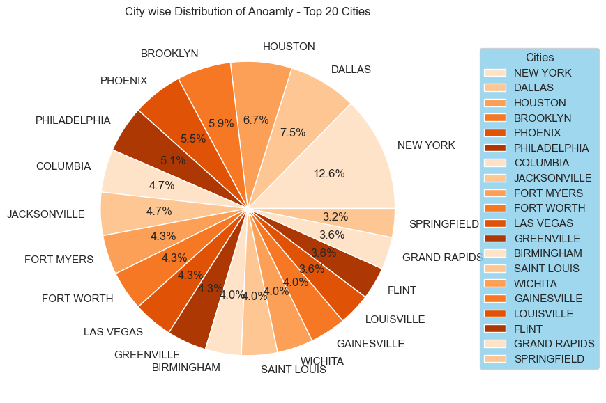
ML- Algorithms
Elliptic Envelope
The Pie chart on left shows Distribution of Anomalies in Top 20 Cities:
Where
New York city has highest no of anomalies around 12.60% in total.
Followed by the Dallas city 7.50% anomaly and Houston with around 6.70% anomaly.
The Pie- chart on right shows the Top 20 Credentials with highest anomalies :
Where
MD credentials has the highest no of anomalies around 84.60% anomalies.
PT credential has comparatively small no of anomalies in 6.3%

Slide 22
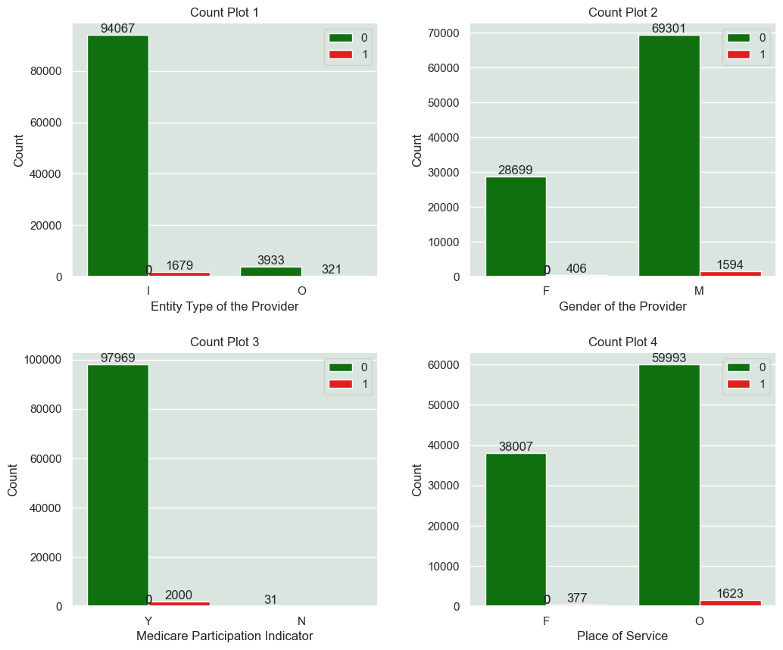
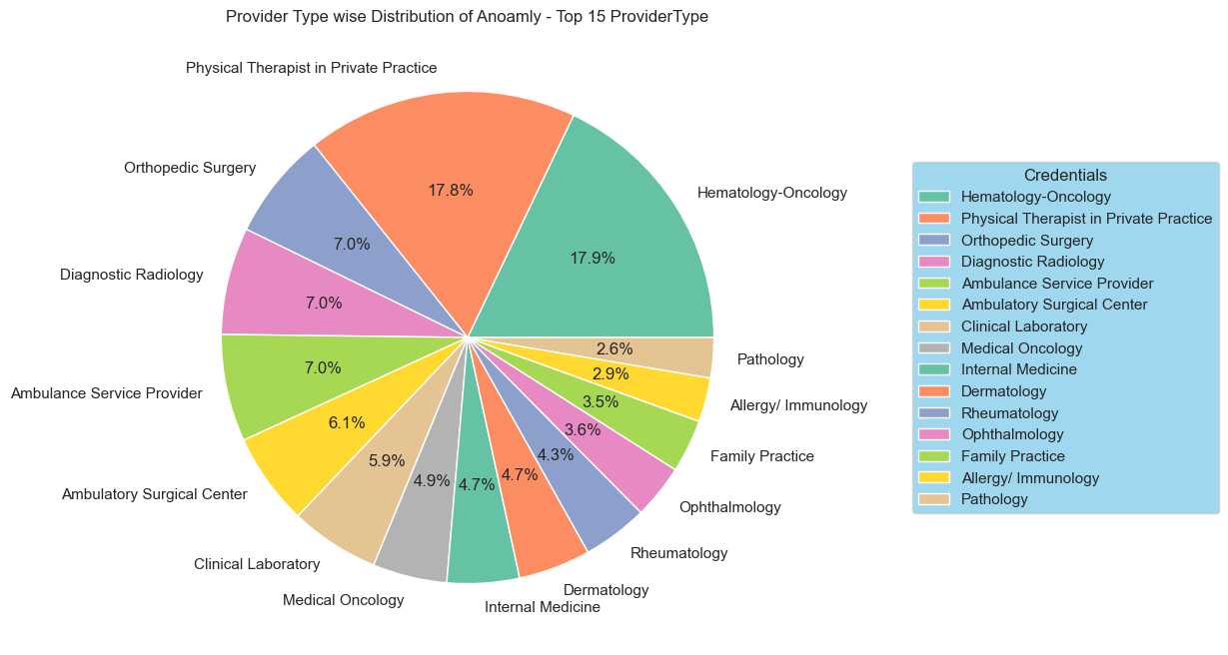
ML- Algorithms
Elliptic Envelope
Gender | Entity | Place | Medicare Participation indicator
Male-1594 | Individual-1679 | Facility-377 | Yes-2000
Female-406 | Organization-321 | Non-Facility -1623 | No-0
The pie chart below shows the distribution of Anomalies in Top 15 Provider Type:
Where
Hematology Oncology has the highest no of anomalies 17.9%
Followed by Physical Therapist in Private Sector which has 17.8% , Diagnostic Radiology has 7.0% anomalies

Slide 23
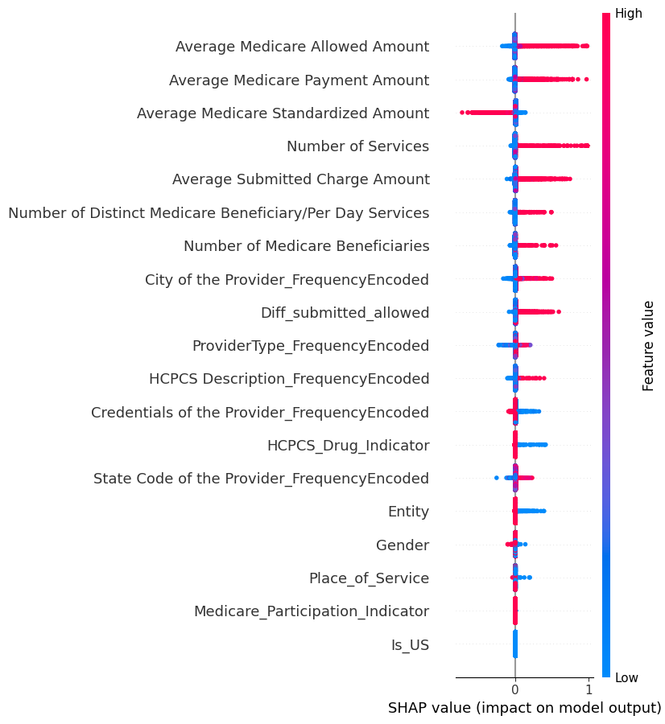
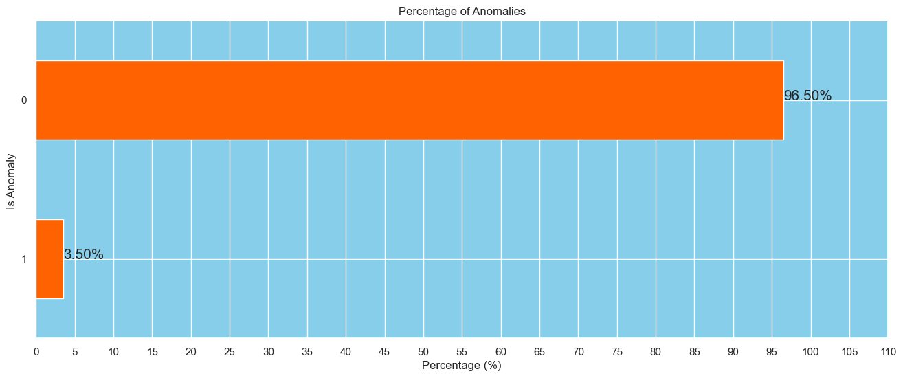
ML- Algorithms
One-Class SVM
The SHAP Analysis of One-class SVM the impact of columns on result/Prediction:
Where
Above plot shows that Average medicare payment amount & average medicare allowed amount has high positive impact on the model where as Average medicare standardized amount has negatively effected model output
The numerical columns has significantly contributed in decision making while only categorical value which is city has contributed to some extent.
The barplot below shows the anomaly detected by the Elliptic Envelope is 3.50% i.e.3500.
Contamination Parameter : 0.035

Slide 24
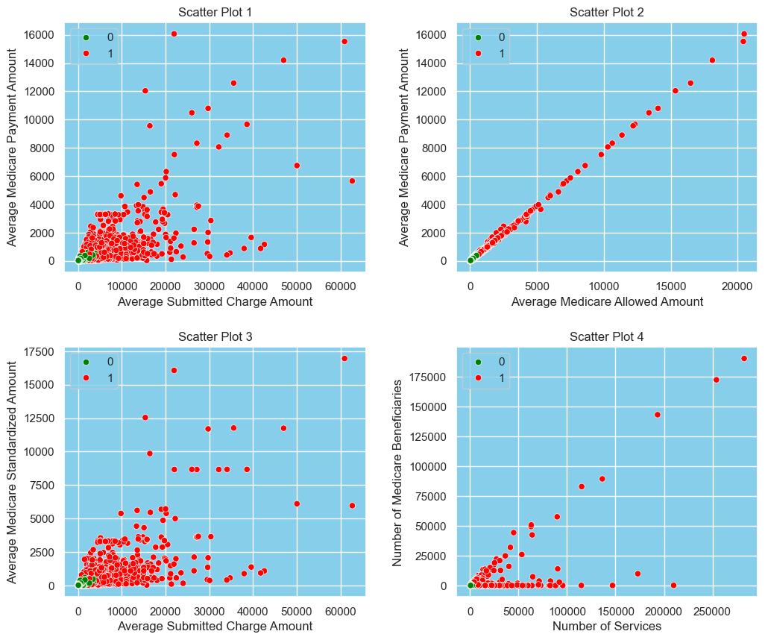
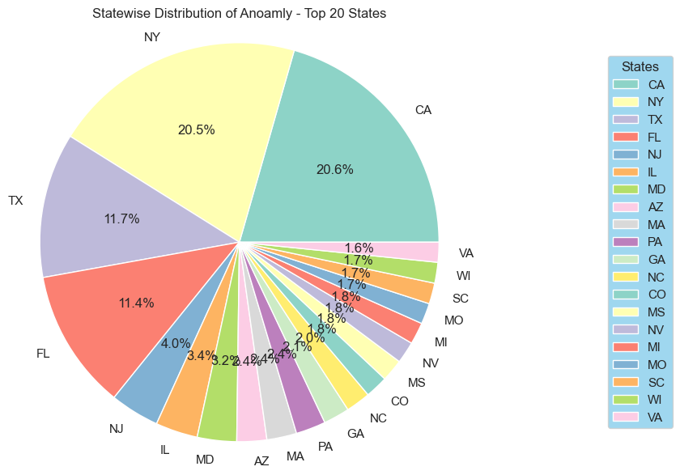
ML- Algorithms
One-Class SVM
The Scatter-plots on left shows Distribution of Anomalies by applying One-class SVM :
Where
Red dots shows anomaly and Green dot Normal datapoints.
We can see that One class SVM is able to distinguishes between normal and anomalies.
The Pie- chart below shows the Top 20 states with highest anomalies :
Where
California state has highest no of anomalies around 20.60% in total.
Follwed by New YORK with 20.50% and Texas with 11.7%

Slide 25
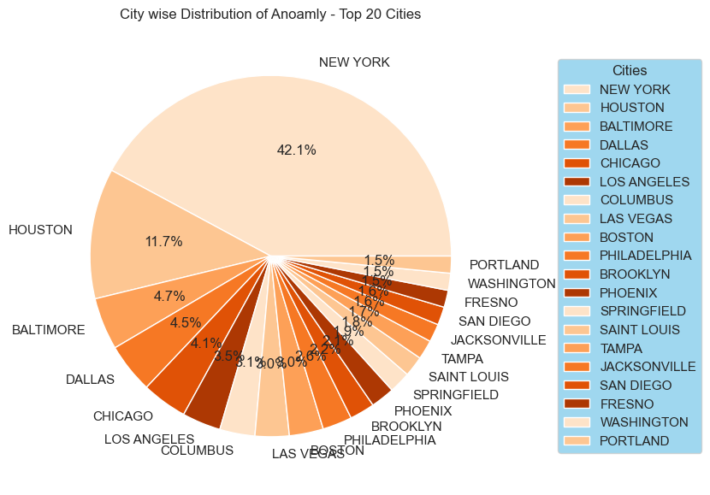
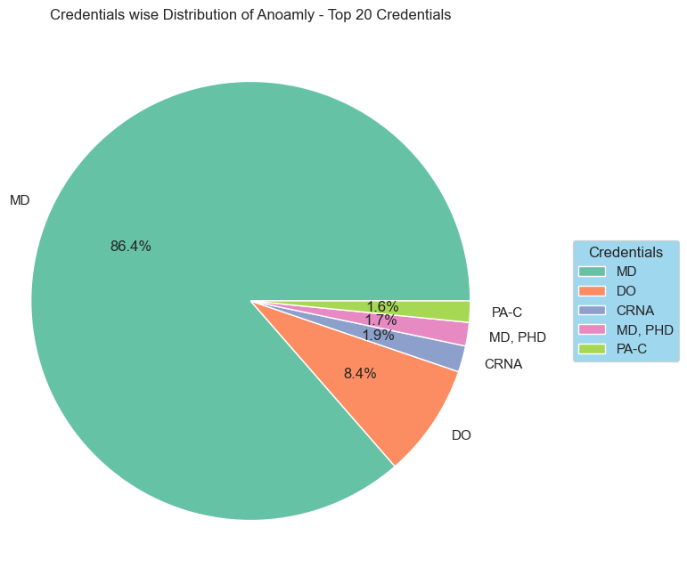
ML- Algorithms
One-Class SVM
The Pie chart on left shows Distribution of Anomalies in Top 20 Cities:
Where
New York city has highest no of anomalies around 42.10% in total.
Followed by the Huston city with 11.70% anomaly and Baltimore with around 4.7% anomaly.
The Pie- chart on right shows the Top 20 Credentials with highest anomalies :
Where
MD credentials has the highest no of anomalies around 86.40% anomalies.
DO credential has comparatively small no of anomalies in 8.4%

Slide 26
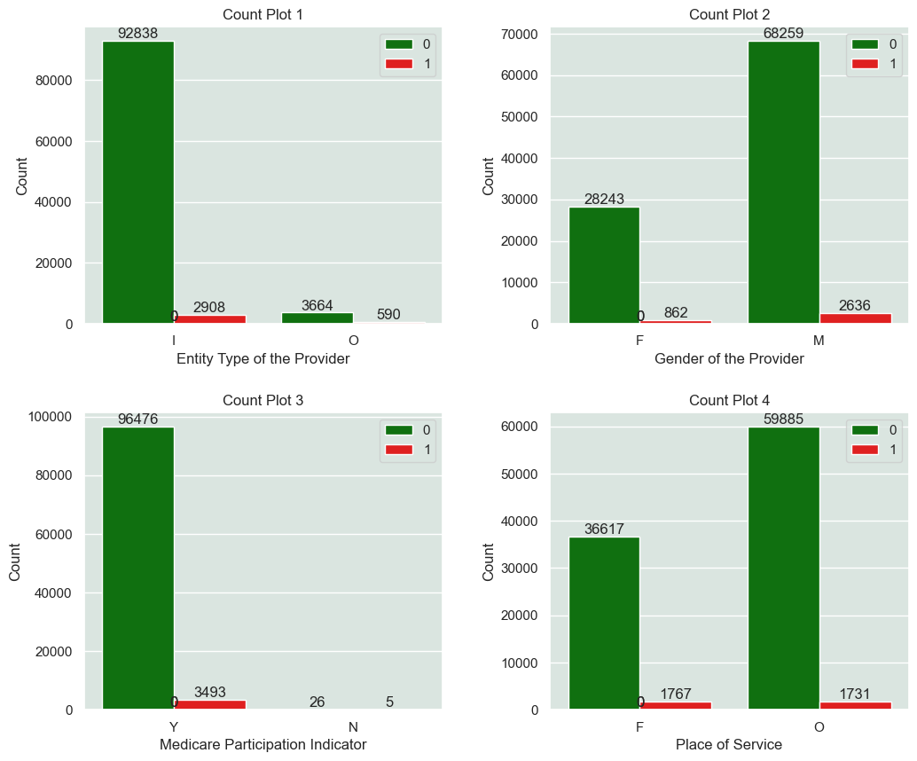
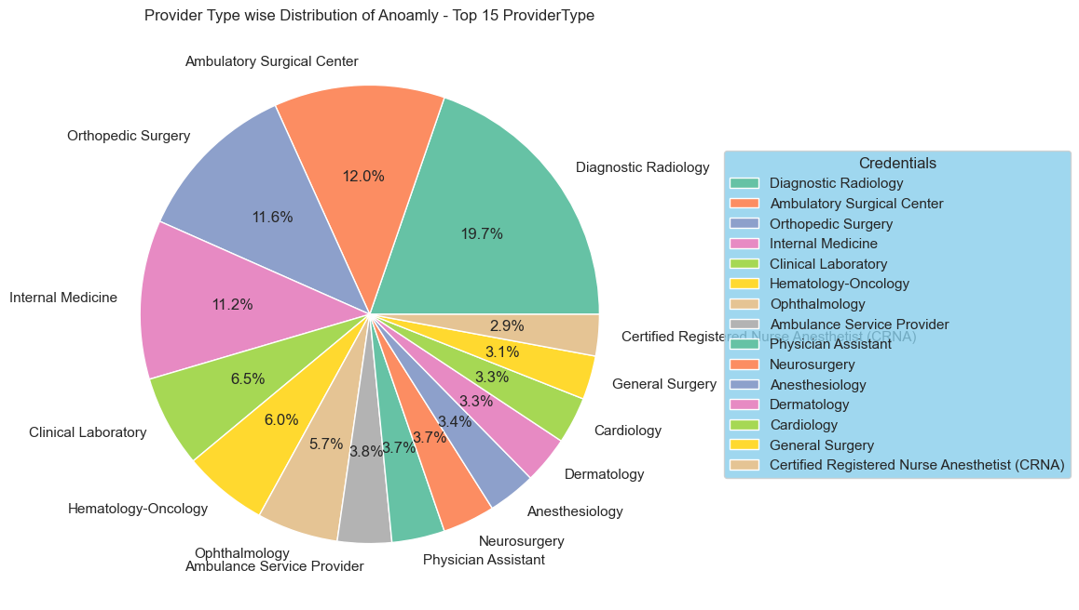
ML- Algorithms
One-Class SVM
Gender | Entity | Place | Medicare Participation indicator
Male-2636 | Individual-2908 | Facility-1767 | Yes-3493
Female-862 | Organization-590 | Non-Facility -1731 | No-5
The pie chart below shows the distribution of Anomalies in Top 15 Provider Type:
Where
Diagnostic Radiology has the highest no of anomalies 19.7%
Followed by Ambulatory surgical Center which has 12.0% ,Orthopedic surgery has 11.6% anomalies

Slide 27
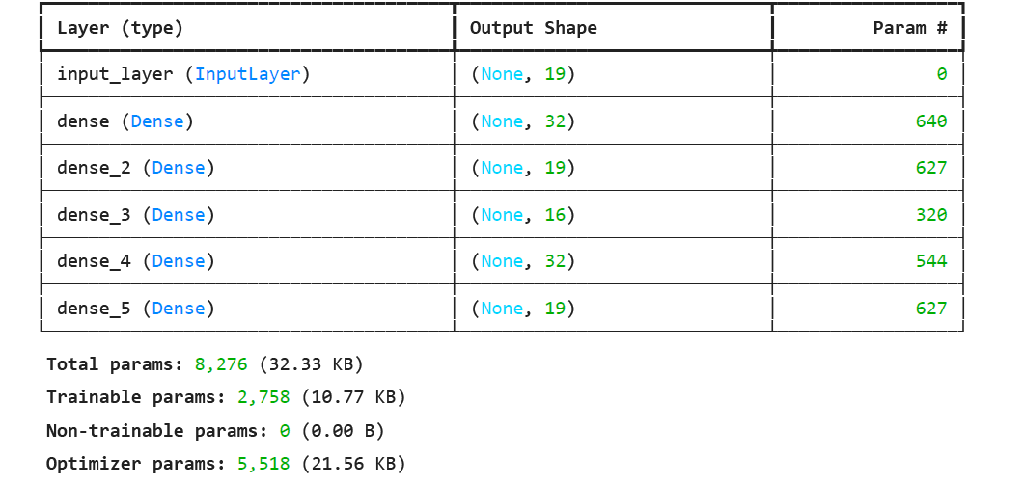
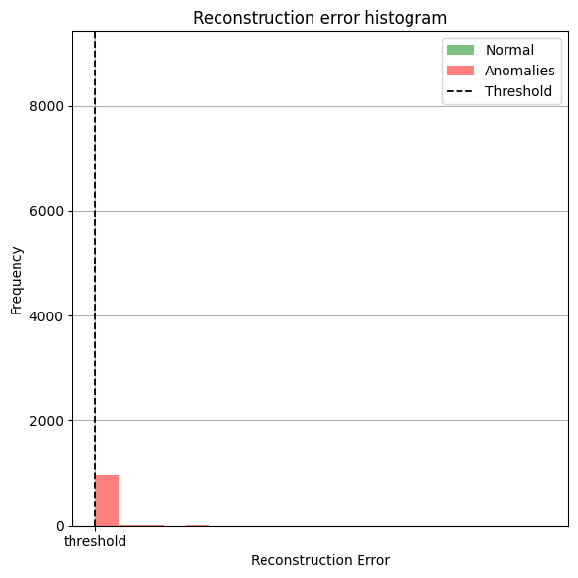
Deep Learning - Autoencoder
The table shows the summary of DL model and the Description of model and the parameters where we can see shape and the parameters layer by layer
The left Histogram shows the anomaly based on the reconstruction error where dotted black vertical line which is threshold is dividing the anomalous data .

Slide 28
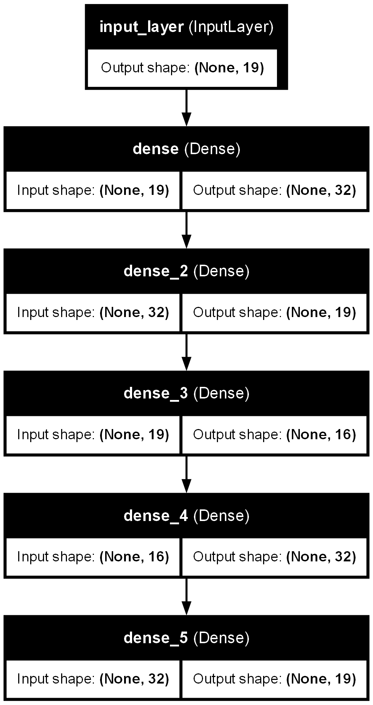
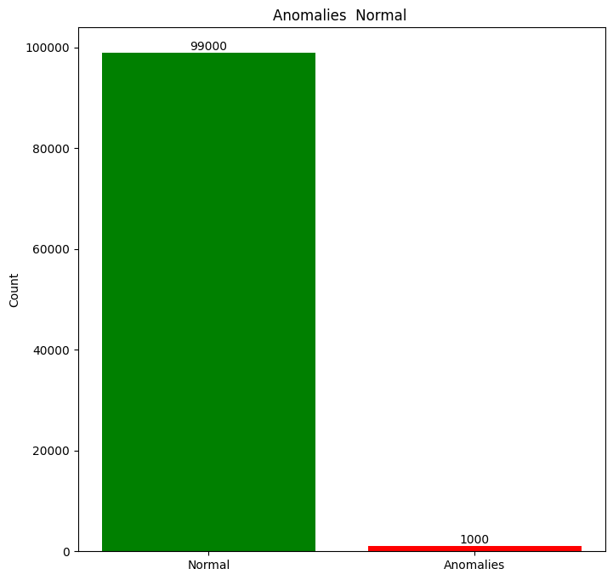
Deep Learning - Autoencoder
The flow chart show the Model Architecture and layers with details such as input data and output data and shape flow of algorithm
The Histogram Green Bar shows the Normal Entries which are around 99000 in total Red bar shows anomalies which are detected by the Autoencoders.

Slide 29

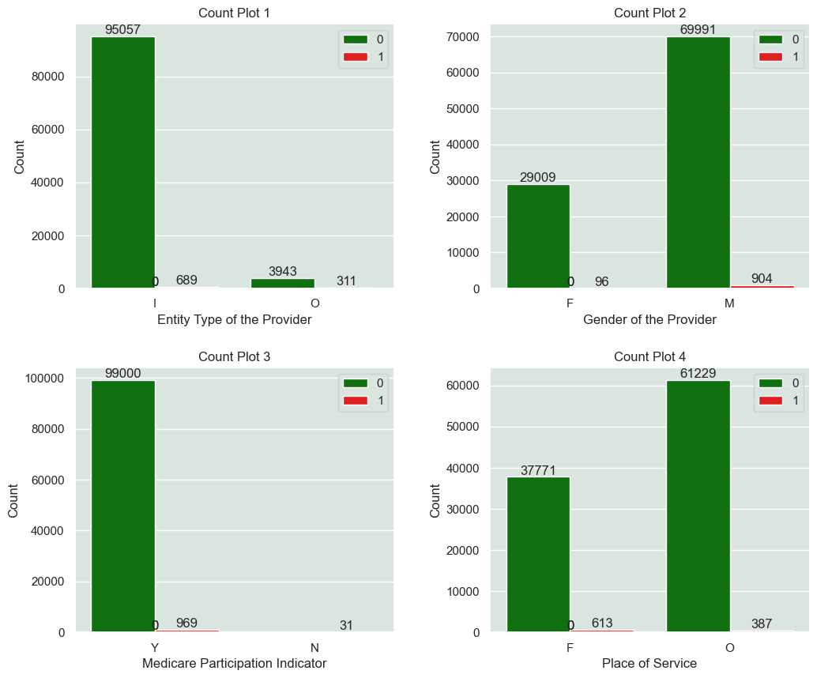
Deep Learning - Autoencoder
The Scatter-plots on left shows Distribution of Anomalies by applying Autoencoder:
Where
Red dots shows anomaly and Green dot Normal datapoints.
We can see that Elliptic Envelope is able to distinguishes between normal and anomalies.
Gender | Entity | Place | Medicare Participation indicator
Male-904 | Individual-689 | Facility-613 | Yes-969
Female-96 | Organization-311 | Non-Facility -387 | No-31

Slide 30
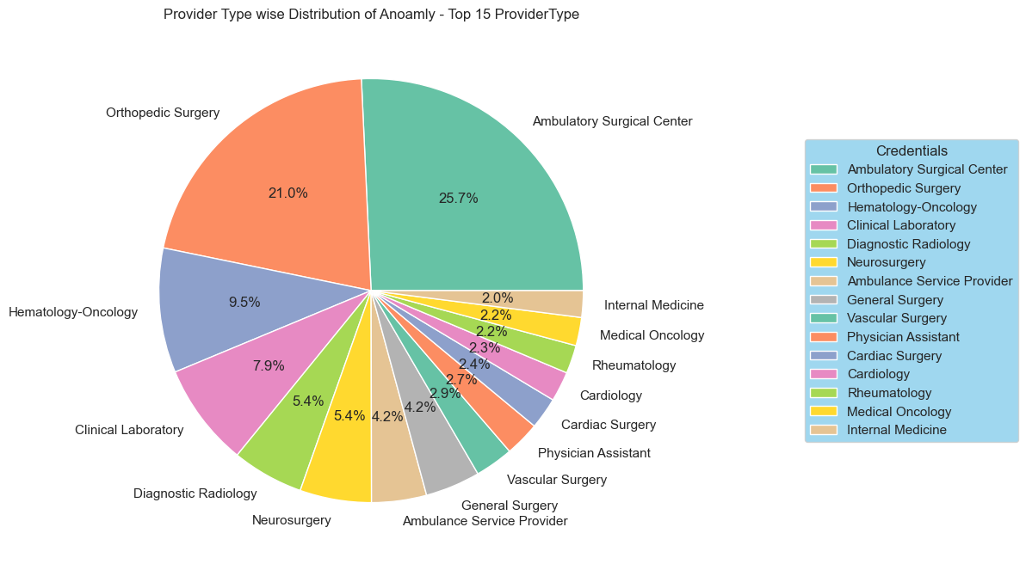
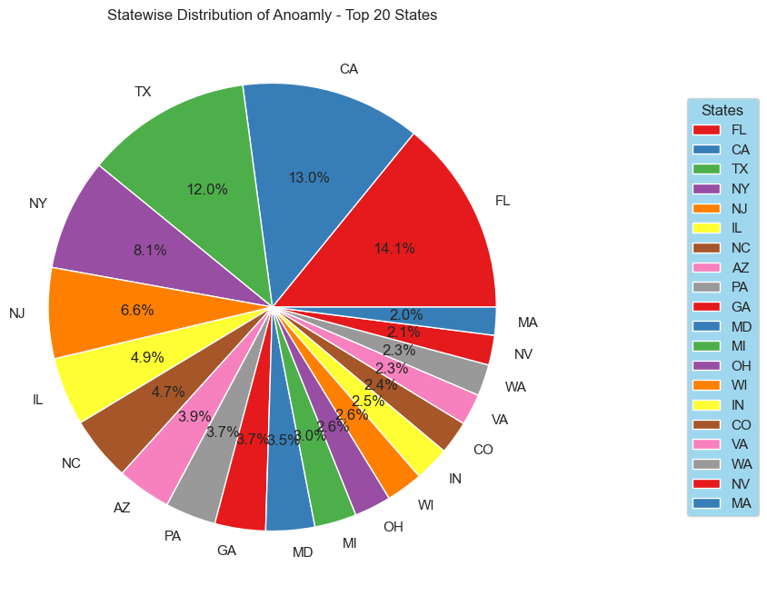
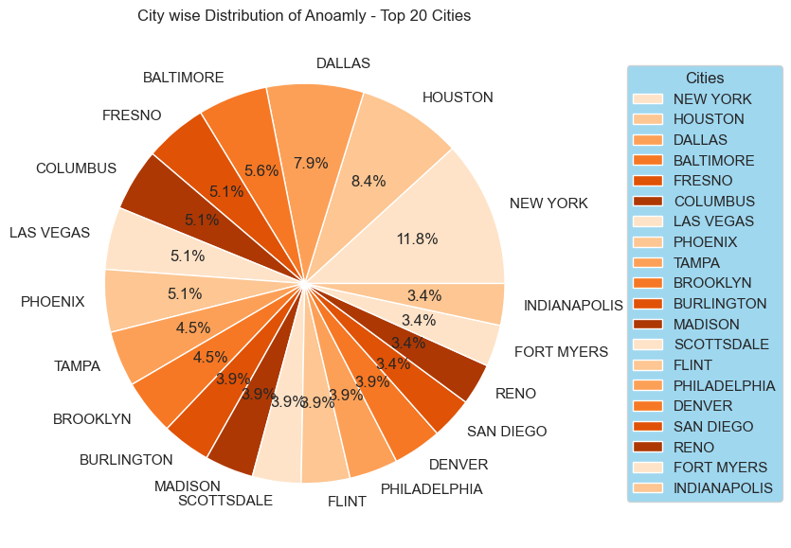
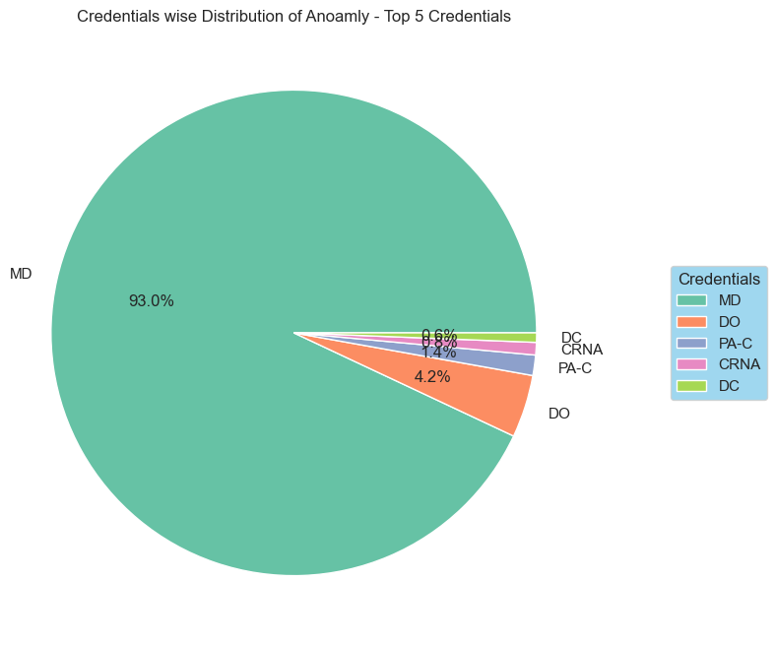
Deep Learning - Autoencoder
Categorical columns
Anomalies
In Percentage

Slide 31


